Slide 1
Modelling, Simulation, and Optimization Summer term 2019 Shape Optimization of Submarines
28.05.2019

Slide 2
Outline…
Objective
Model
Optimization Algorithm
NSE and Boundary conditions
Solution of NSE and Solver details
Objective function
Adjoint Equation and Boundary conditions
Coordinate update by weighted gradient method
References

Slide 3
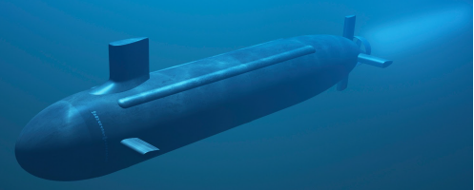
Objective
Obtain optimized Submarine body shape, as streamlined as possible, for better fuel efficiency.
Generate a PDE model with physically meaningful boundary conditions, describing laminar flow around Submarine body with volume, radial symmetry constraints
Some family of body shapes that are superior in terms of fuel efficiency

Slide 4
Model
Objective function, J = f(D) with design variable X
D - Drag Force on the body
X - Coordinates of the boundary
of the body (𝜞_{B})
𝜞_{S}
𝜞_{B}
Ω
𝜞_{D}
𝜞_{U}
𝜞_{S}

Slide 5
Optimization Algorithm
1
2
Results: u,p
3
Results: u*,p*
Initial Model with Coordinates X⁽⁰⁾
Solving NSE with BCs
Solving Optimality Criterion Eqn with BCs
OpenFoam
OpenFoam
(Not
Satisfied)
7
6
5
4
Optimal Model with X^{(f)}
Convergence Criteria
| X^{(i+1)} - X^{(i)}| < 𝜺
1
Update Coordinates X^{(i+1)} using Weighted Gradient Method
Compute grad(J) = f(u,p,u*,p*)
(Satisfied)
Prog. Language
Prog. Language

Slide 6
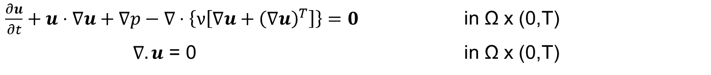
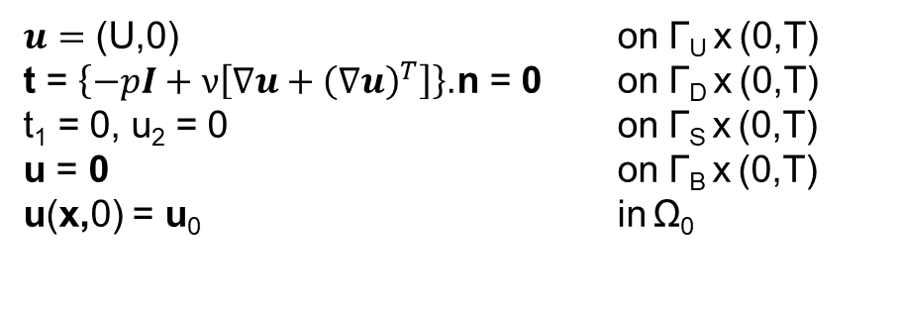
Navier Stokes Equation
Boundary Conditions

Slide 7
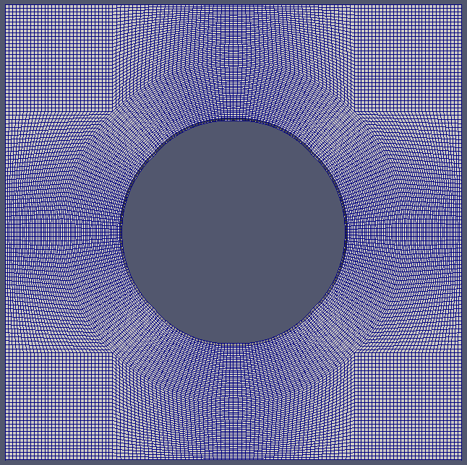
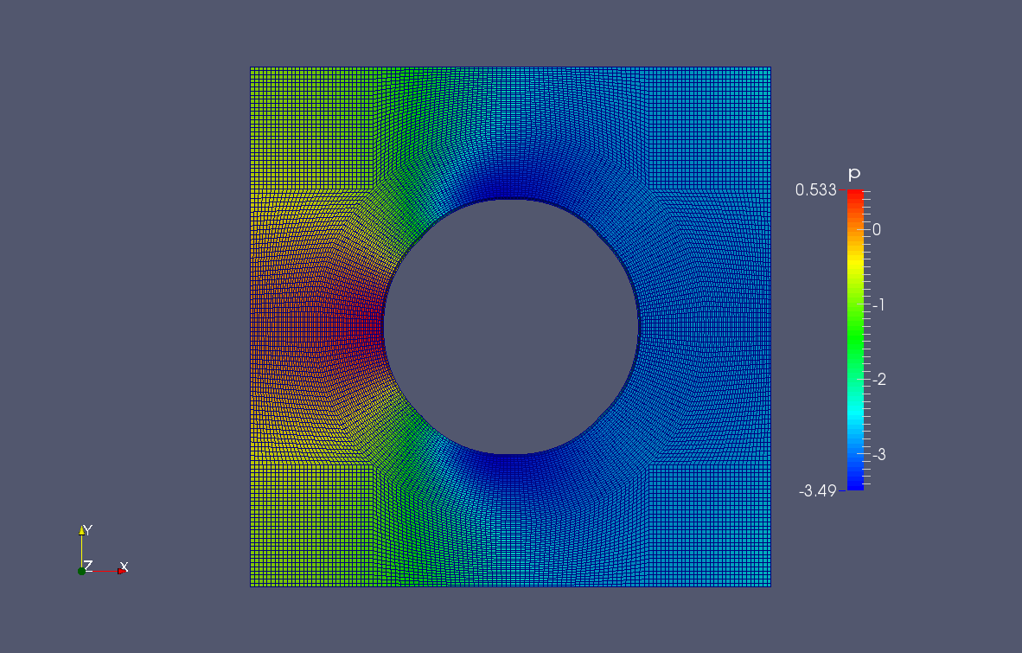
Initial Model
u - symmetry
p - symmetry
u = (1,0,0)
p – Zero gradient
u – Zero gradient p – Zero gradient
u = (0,0,0)
p – Zero gradient
u - symmetry
p -symmetry

Slide 8
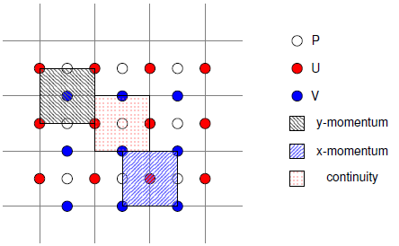
Solver – Predictor Corrector Approach
Staggered grid - pressure is stored in the centre of the CV and the velocity components are shifted by Δx/2 upward or sideward onto the cell faces
Step 1: Prediction - Solve the momentum equation by neglecting the pressure gradient. The predicted velocities, don’t fulfil mass conservation equation
Step 2: Poisson Equation – Solve to estimate pressure for new time level
Step 3: Correction – use pressure correction variables to correct pressure and velocity fields. Mass conservation improves.
Repeat step 1 to 3 with the new estimated values

Slide 9
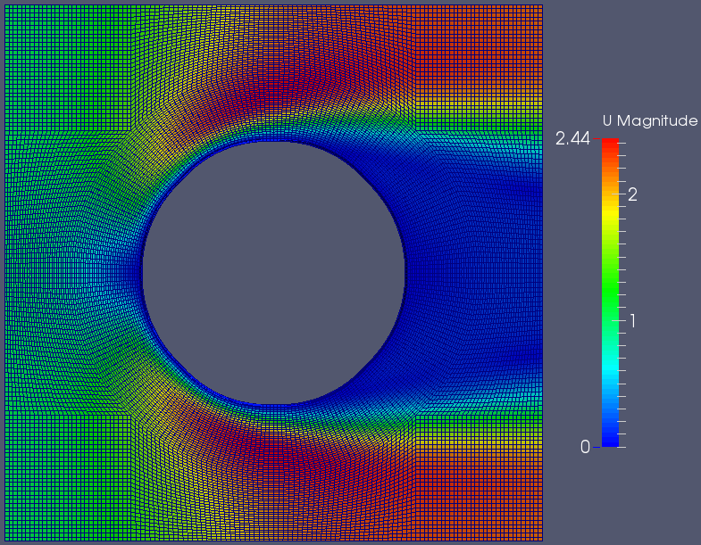
Solution of NSE - Velocity

Slide 10
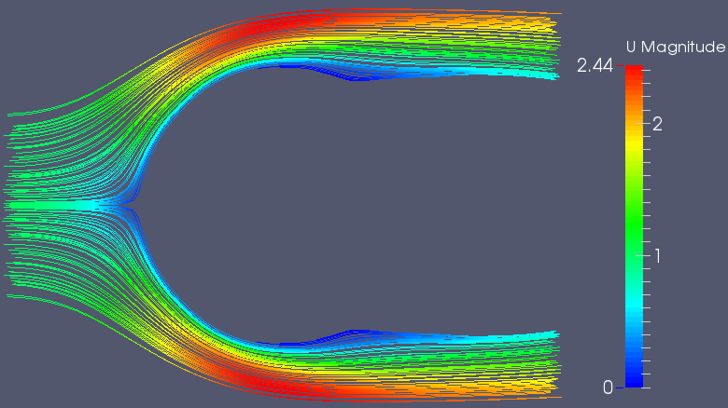
Solution of NSE - Streamline

Slide 11
Solution of NSE - Pressure

Slide 12
Solution of NSE – Drag Force
Drag force = Pressure force + Viscous force

Slide 13
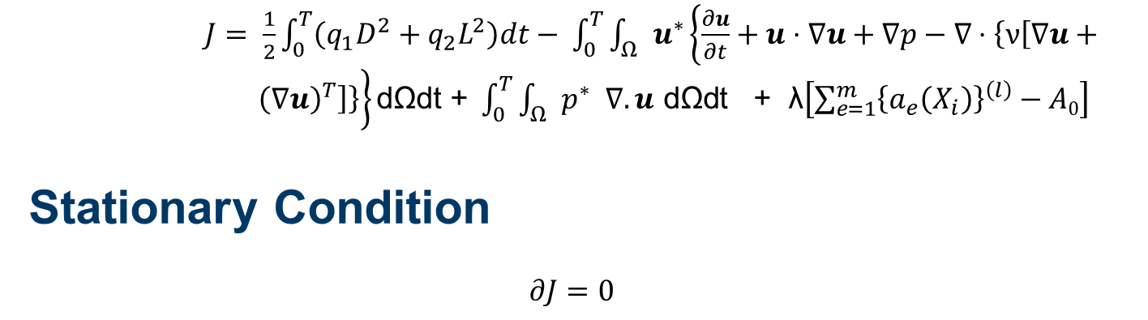
Objective function

Slide 14
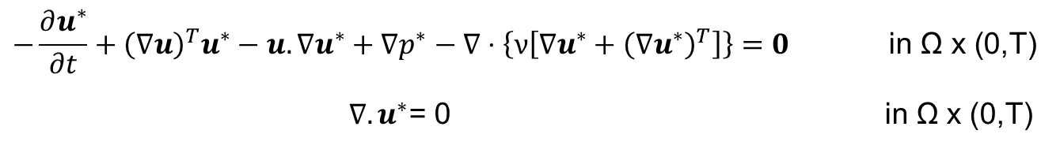
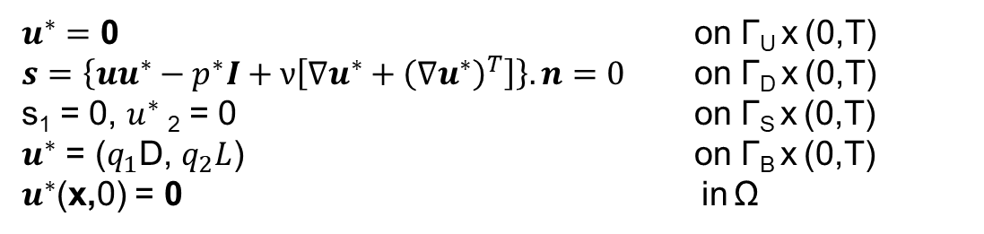
Adjoint Equation
Adjoint Boundary Conditions

Slide 15
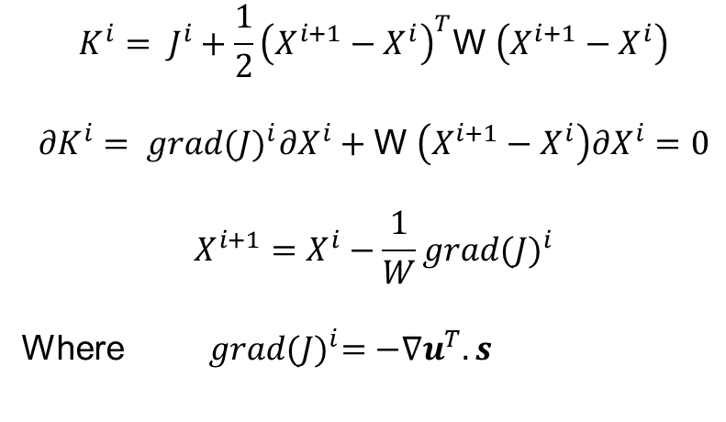
Weighted Gradient Method

Slide 16
Future Work
Solver creation for Optimization objective function
Mesh improvements

Slide 17
References
1. Shape optimization of body located in incompressible Navier-Stokes flow based on optimal control theory – H. Okumura, M.Kawahara
2. Shape optimization of an oscillating body in fluid flow by adjoint equation and ALE Finite Element Methods – Hiroki Yoshida and Mutsuto Kawahara.

Slide 18
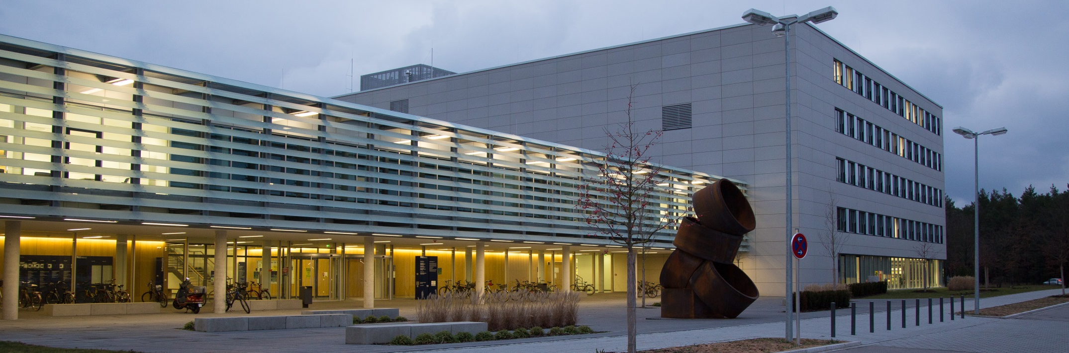
THANK YOU

